Slide 1
Schedule Representation
Tasks | Duration (Days) | Dependencies
T1 | 10
T2 | 5 | T1
T3 | 4 | T1
T4 | 6 | T2
T5 | 9 | T3
T6 | 5 | T4,T5

Slide 2
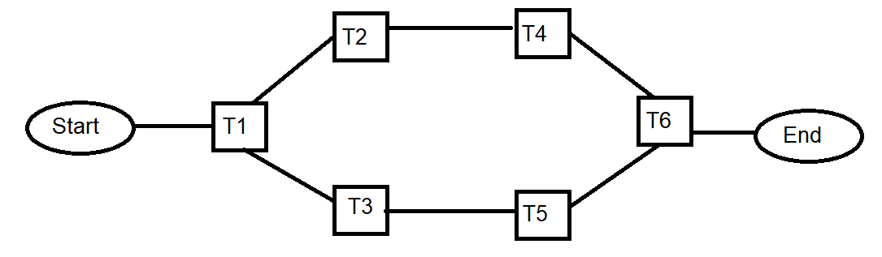
Schedule Representation
Tasks | Duration (Days) | Dependencies
T1 | 10
T2 | 5 | T1
T3 | 4 | T1
T4 | 6 | T2
T5 | 9 | T3
T6 | 5 | T4,T5
Path1: Start- T1-T2-T4-T6 –End=26 days
Path2: Start- T1-T3-T5-T6 –End=28 days

Slide 3
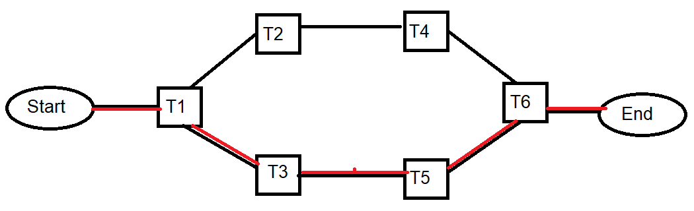
Schedule Representation
Tasks | Duration (Days) | Dependencies
T1 | 10
T2 | 5 | T1
T3 | 4 | T1
T4 | 6 | T2
T5 | 9 | T3
T6 | 5 | T4,T5
Path1: Start- T1-T2-T4-T6 –End=26 days
Path2: Start- T1-T3-T5-T6 –End=28 days
(Critical Path)

Slide 4
Purpose of a Task Network
Also called an activity network
It is a graphic representation of the task flow for a project
It depicts task length, sequence, concurrency, and dependency
Points out inter-task dependencies to help the manager ensure continuous progress toward project completion
The critical path
A single path leading from start to finish in a task network
It contains the sequence of tasks that must be completed on schedule if the project as a whole is to be completed on schedule
It also determines the minimum duration of the project
4
Notes:
4

Slide 5
Example Task Network
Task F
2
Task G
3
Task H
5
Task B
3
Task N
2
Task A
3
Task C
7
Task E
8
Task I
4
Task J
5
Task M
0
Task D
5
Task K
3
Task L
10
Where is the critical path and what tasks are on it?
5
Notes:
5

Slide 6
Example Task Network with Critical Path Marked
Task F
2
Task G
3
Task H
5
Task B
3
Task N
2
Task A
3
Task C
7
Task E
8
Task I
4
Task J
5
Task M
0
Task D
5
Task K
3
Task L
10
Critical path: A-B-C-E-K-L-M-N
6
Notes:
6

Slide 7
Work Breakdown Structure
It represents a logical decomposition of the work to be performed and focuses on how the product, service, or result is naturally subdivided. It is an outline of what work is to be performed.

Slide 8
40-20-40 Distribution of Effort
A recommended distribution of effort across the software process is
40% (analysis and design)
20% (coding)
40% (testing)‏
Work expended on project planning rarely accounts for more than 2 - 3% of the total effort
Requirements analysis may comprise 10 - 25%
Effort spent on prototyping and project complexity may increase this
Software design normally needs 20 – 25%
Coding should need only 15 - 20% based on the effort applied to software design
Testing and subsequent debugging can account for 30 - 40%
Safety or security-related software requires more time for testing
8
(More on next slide)‏
Notes:
8

Slide 9
40-20-40 Distribution of Effort (continued)‏
Example: 100-day project
6/1
6/4
6/23
7/14
8/2
9/5
P
Analysis
Design
Coding
Testing
40
20
40
9
Notes:
9

Slide 10
Developing WBS
The WBS Should Be Deliverable-Oriented
Ensure WBS allows for the delivery of all the project’s deliverables as defined in project scope
Developing the WBS should involve the people who will be doing the Work

Slide 11
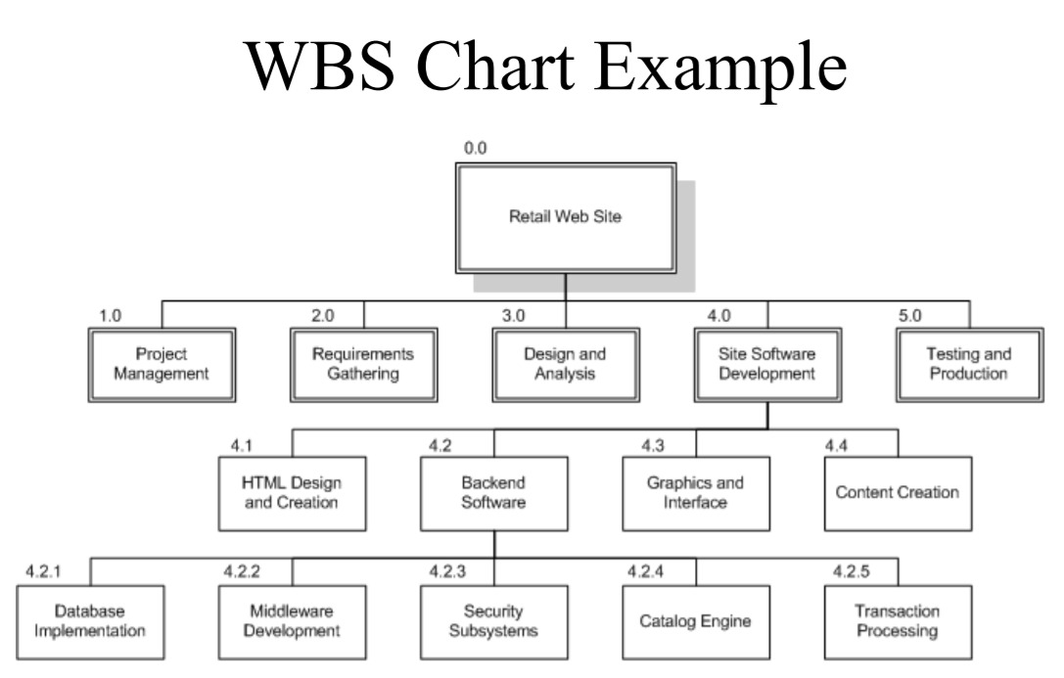
Example of WBS with Estimated Task Durations

Slide 12
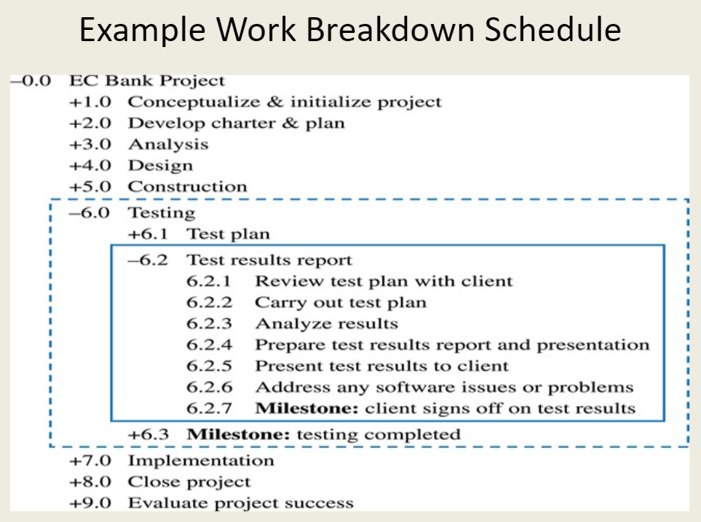

Slide 13
Example of WBS with Estimated Task Duration
6.2 Test Result Report
6.2.1 Review test plan with client 1 day
6.2.2 Carry out test plan 5 days
6.2.3 Analyze result 2 days
6.2.4 Prepare test result report &presentation 3 days
6.2.5 Present test result to client 1 day
6.2.6 Address any s/w issue or problem 5 days

Slide 14
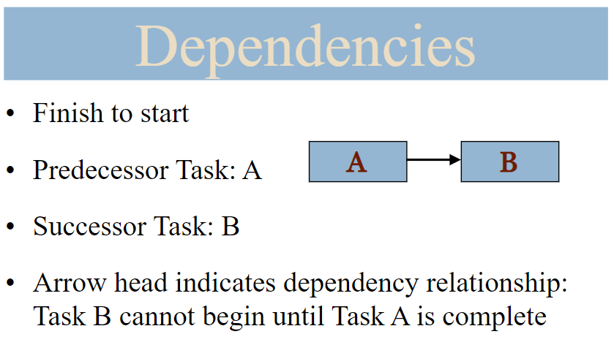

Slide 15
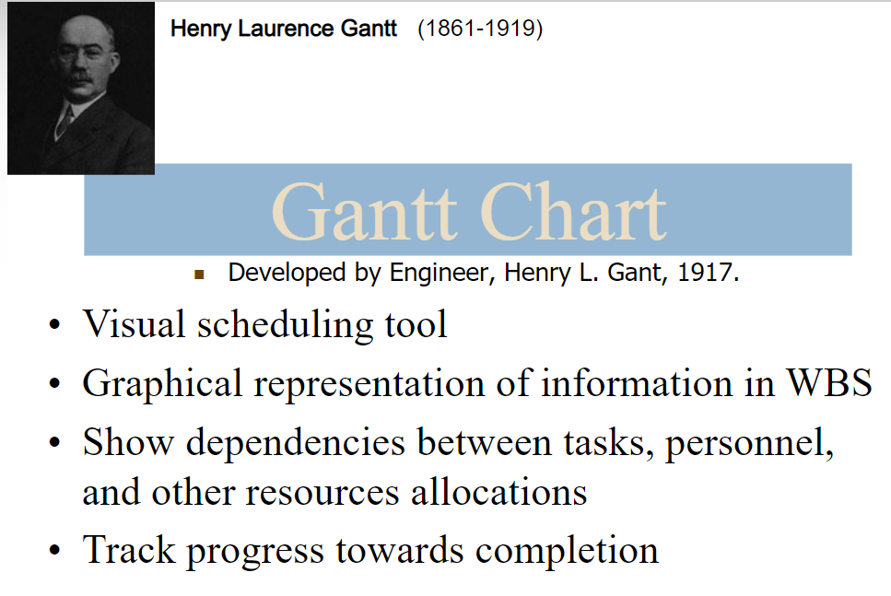

Slide 16
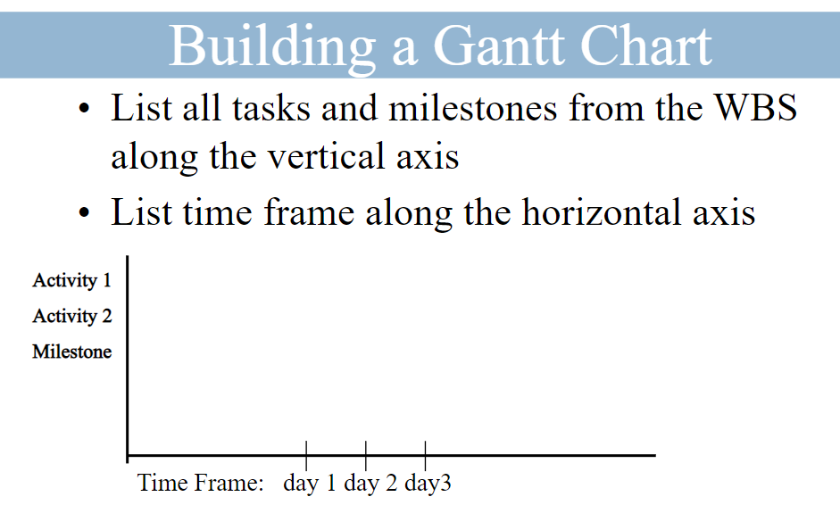

Slide 17
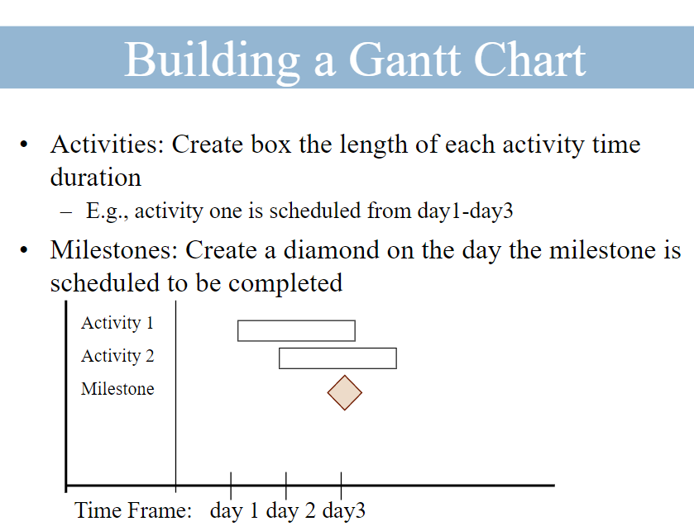

Slide 18
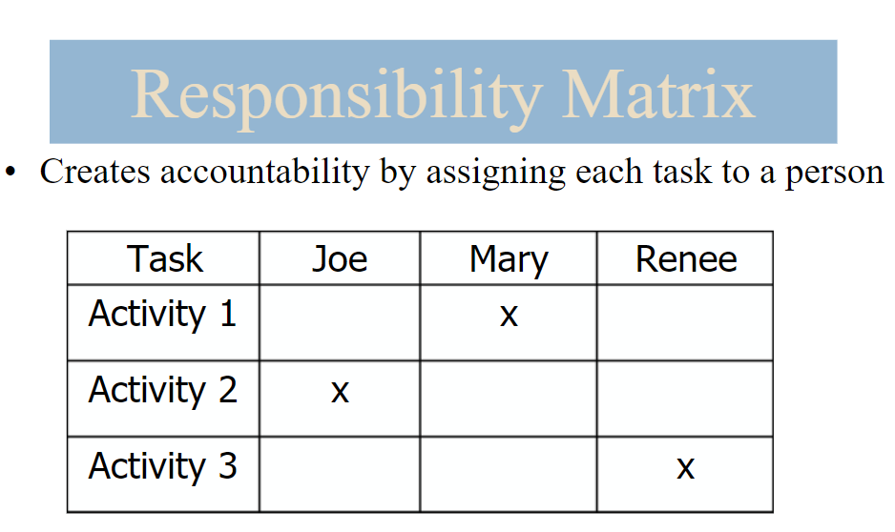

Slide 19
Timeline Chart
Notes:
19

Slide 20
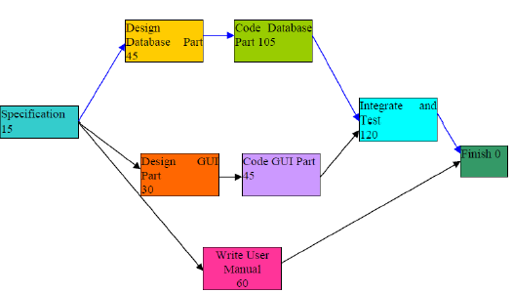
Task Network-Example of MIS

Slide 21
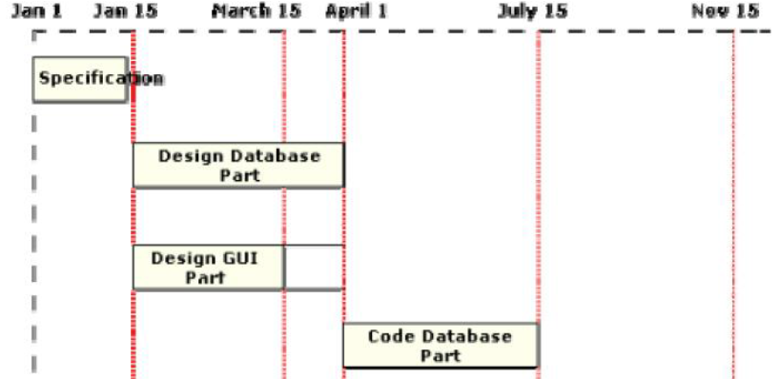
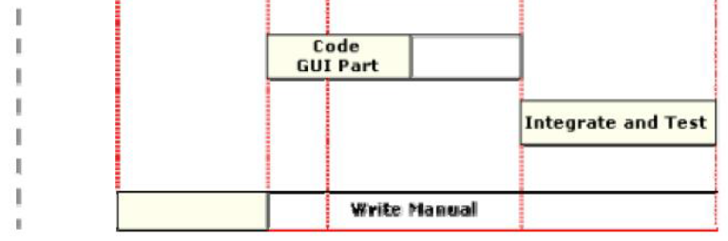
Example of Gantt Chart

Slide 22
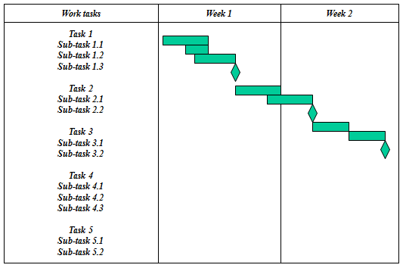
Example of Gantt Chart

Slide 23
Mechanics of a Timeline Chart
Also called a Gantt chart; invented by Henry Gantt, industrial engineer, 1917
All project tasks are listed in the far left column
The next few columns may list the following for each task: projected start date, projected stop date, projected duration, actual start date, actual stop date, actual duration, task inter-dependencies (i.e., predecessors)‏
To the far right are columns representing dates on a calendar
The length of a horizontal bar on the calendar indicates the duration of the task
When multiple bars occur at the same time interval on the calendar, this implies task concurrency
A diamond in the calendar area of a specific task indicates that the task is a milestone; a milestone has a time duration of zero
Jan Feb Mar Apr May Jun Jul Aug Sep Oct
Task #
Task Name
Duration
Start
Finish
Pred.
1
Task A
2 months
1/1
2/28
None
2
Milestone N
0
3/1
3/1
1
23
Notes:
23

Slide 24
SOLUTION
Timeline chart:
4/1 4/8 4/15 4/22 4/29 5/6 5/13 5/20 5/27 6/3
Task #
Task Name
Duration
Start
Finish
Pred.
A
Establish increments
3
4/1
4/3
None
B
Analyze Inc One
3
4/4
4/6
A
C
Design Inc One
8
4/7
4/14
B
D
Code Inc One
7
4/15
4/21
C
E
Test Inc One
10
4/22
5/1
D
F
Install Inc One
5
5/2
5/6
E
G
Analyze Inc Two
7
4/7
4/13
A, B
H
Design Inc Two
5
4/14
4/18
G
I
Code Inc Two
4
4/19
4/22
H
J
Test Inc Two
6
5/2
5/7
E, I
K
Install Inc Two
2
5/8
5/9
J
L
Close out project
2
5/10
5/11
F, K
Task network and the critical path:
A-B-C-D-E-J-K-L
B. Analyze
Inc One
3
C. Design
Inc One
8
D. Code
Inc One
7
E. Test
Inc One
10
F. Install
Inc One
5
A. Establish
Increments
3
L. Close out
Project
2
G. Analyze
Inc Two
7
H. Design
Inc Two
5
I. Code
Inc Two
4
J. Test
Inc Two
6
K. Install
Inc Two
2
24
Notes:
24

Slide 25
Timeline Charts
Work breakdown is input as a task network
Tasks are assigned to specific person
Consequence of this input is a Timeline chart also called a Gantt Chart
A timeline chart can be developed for the entire project
Separate charts can also be developed for each project function or for each individual working on the project

Slide 26
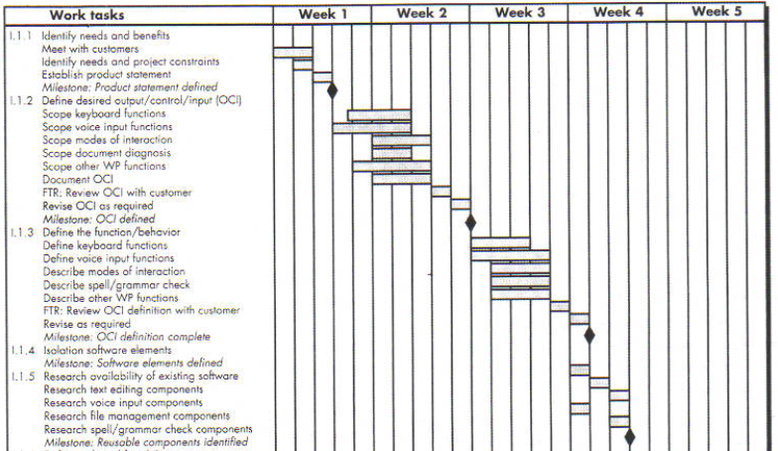
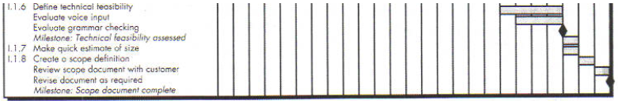
Timeline Charts

Slide 27
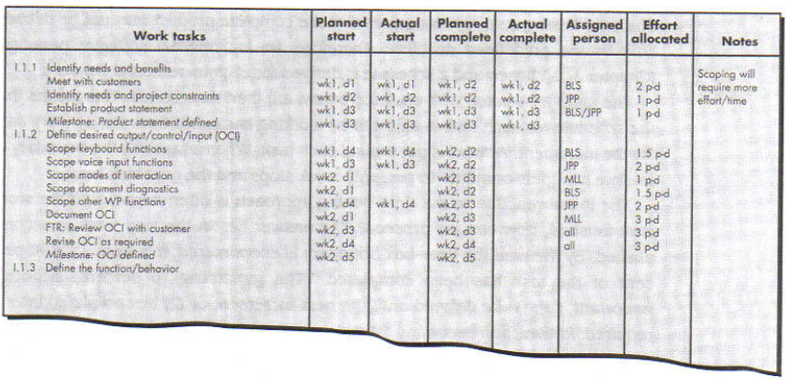
Project Tables/Resource Tables

Slide 28
Tracking Schedule
Project Schedule provides a road map for software project manager
Tracking can be accomplished in the following ways:-
Conducting periodic project status meetings in which each team member reports progress and problems
Evaluating results of all reviews conducted throughout the software engineering process
Determining whether formal project milestones have been accomplished by scheduled date

Slide 29
Tracking Schedule
Comparing actual start-date to planned start-date for each project task listed in the resource table
Meeting Informing with practitioners to obtain their subjective assessment of progress to date and problems on the horizon
Using earned value analysis to assess progress quantitatively

Slide 30
Controlling the Project
Control is employed by a software project manager to administer project resources, cope with problems, and direct project staff
If project is on schedule and within budget then control is light
When problems occur, additional resources may be deployed. Example- staff may be redeployed, project schedule can be redefined
When severe deadline pressure occurs, time boxing technique is used

Slide 31
Contd…
Time Boxing
This strategy recognizes that the complete product may not be delivered by predefined deadline
An incremental software model is chosen and a schedule is derived for each incremental delivery
Schedule for each task is adjusted by working backward from the delivery date for the increment
A “box” is put around each task. When task hits boundary of box, works stops and next task begins

Slide 32
Contd..
Time Boxing
By the time the boundary of time box is encountered, 90% of task has been completed
The remaining 10%
can be delayed until next increment or
can be completed later if required
Rather than becoming stuck on a task, the project proceeds towards delivery date

Slide 33
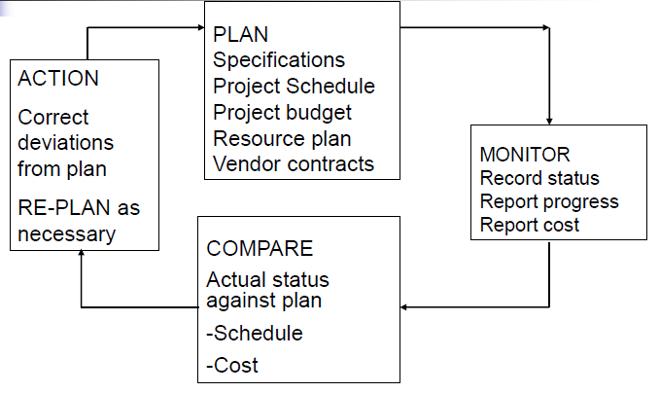
Project Control Cycle

Slide 34
Project Monitoring and Control
Monitoring –collecting, recording, and reporting information concerning project performance that project manger and others wish to know
Controlling –uses data from monitor activity to bring actual performance to planned performance

Slide 35
What is to be monitored?
Inputs
Time
Money
Resources
Material Usage
Tasks
Quality/Technical Performance
Outputs
Progress
Costs
Job starts
Job completion
Engineering / Design changes

